Slide 1
















SMART PARKING SYSTEM
CS4111 - Fall 2023

Slide 2









INTRODUCTION
TABLE OF CONTENT
HARDWARE
SOFTWARE
RELATED WORK & CONCLUSION

Slide 3







INTRODUCTION
Back to table of Content

Slide 4



Intro
Urbanization and increased vehicles strain parking efficiency, causing congestion.
Our solution, the 'Smart Parking System,' utilizes Arduino and sensors for an intelligent, safe parking solution.
Back to table of content

Slide 5
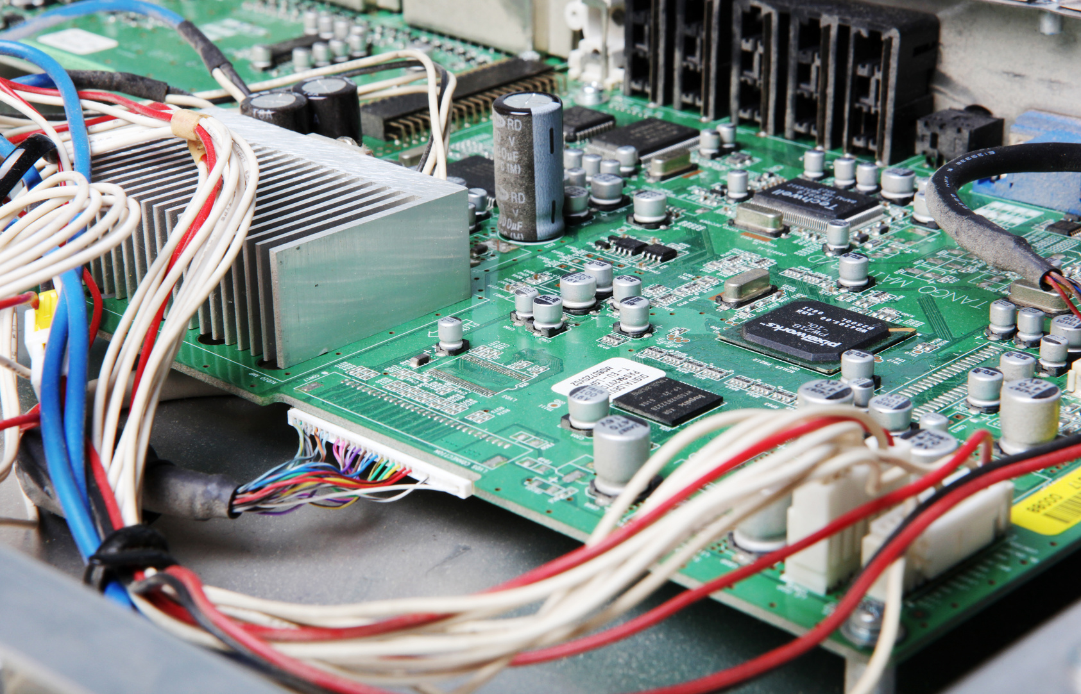


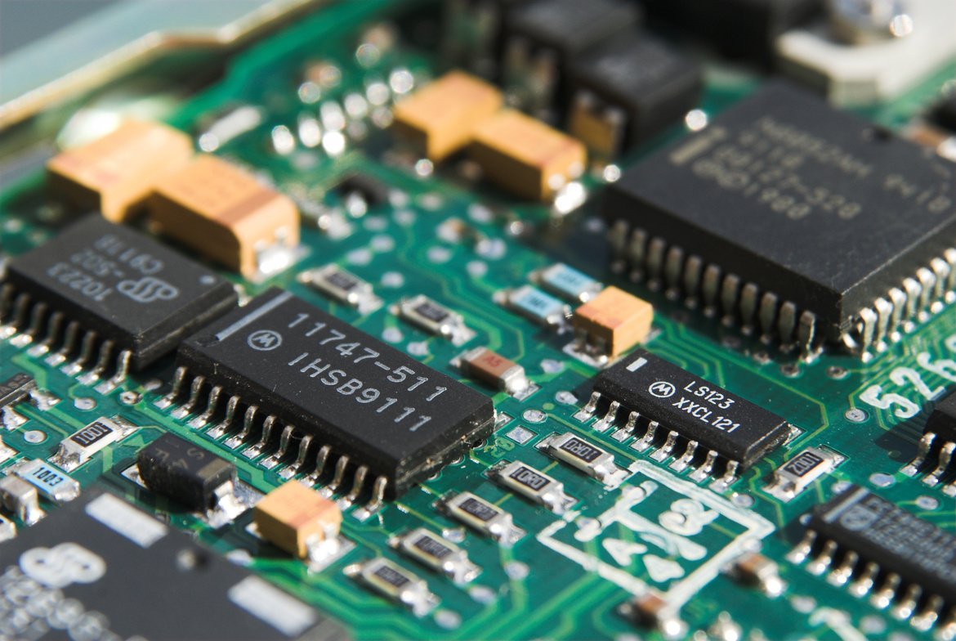

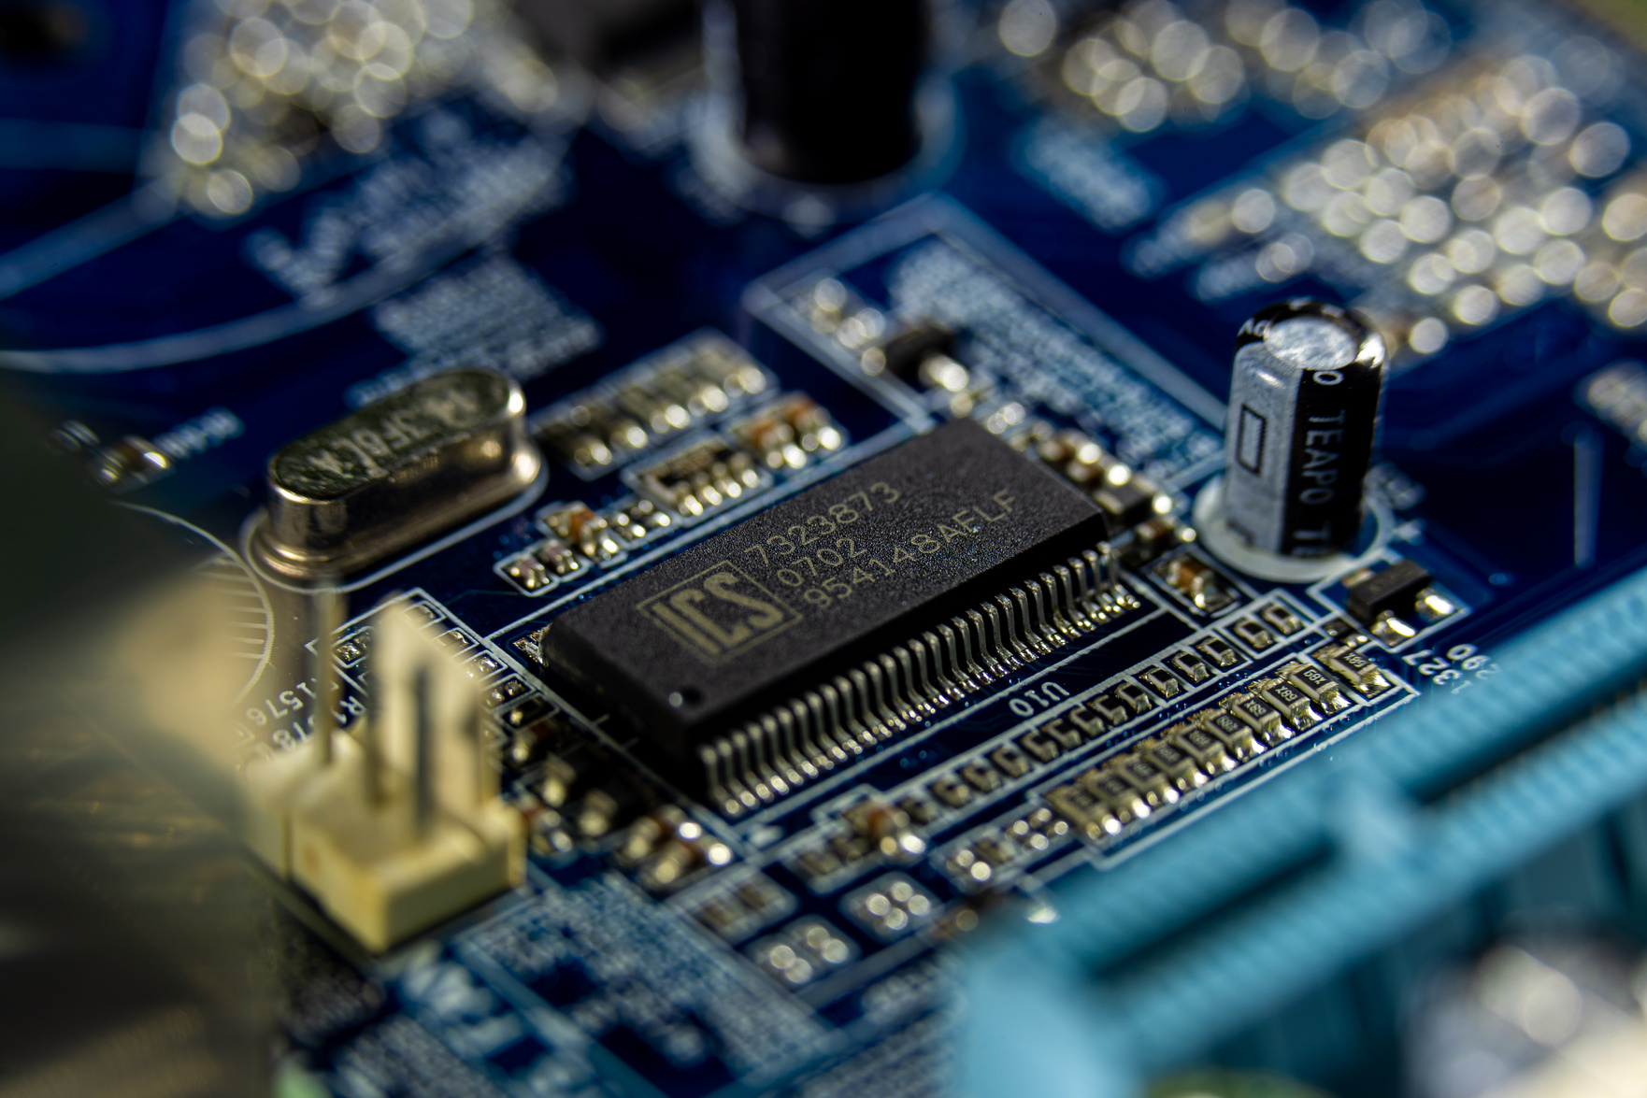



HARDWARE
Hardware used to make this project
Back to table of content

Slide 6
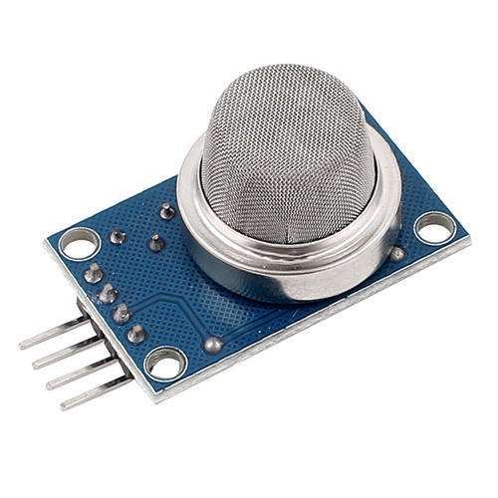
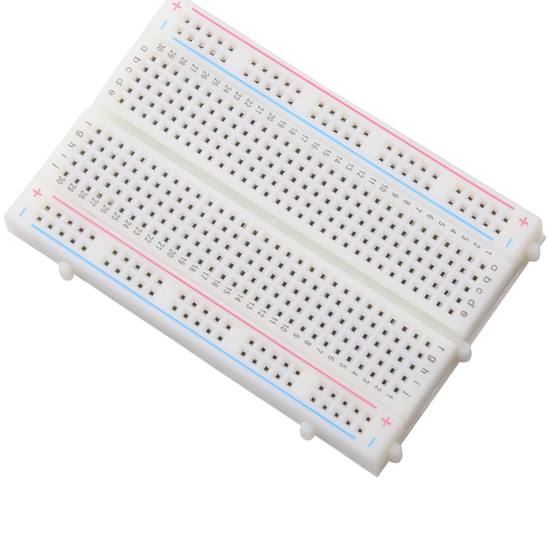


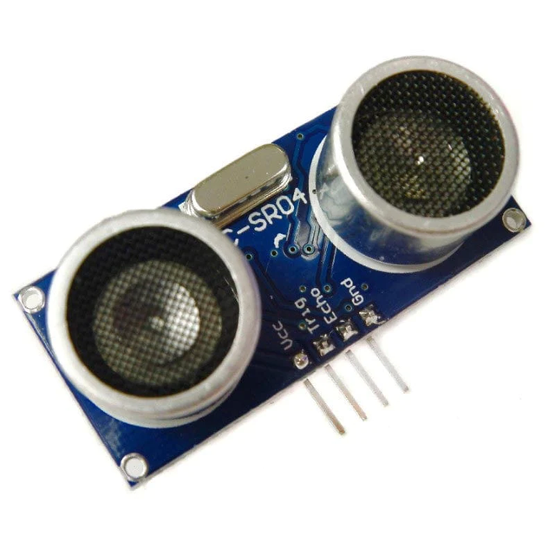

THE HARDWARE COMPONENTS
1 breadboard
1 smoke sensor
3 ultrasonic distance sensors
Back to table of content

Slide 7
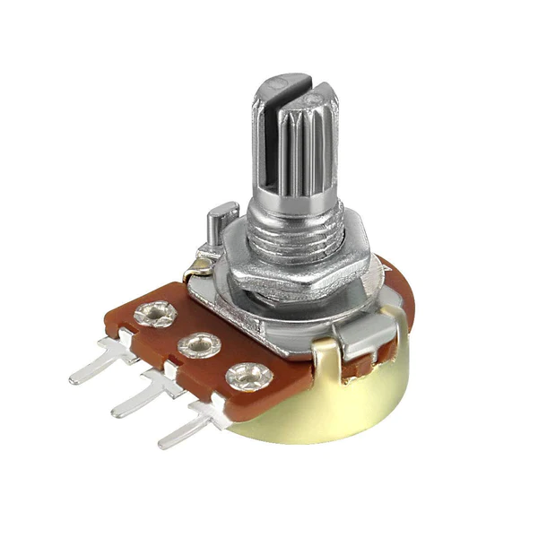
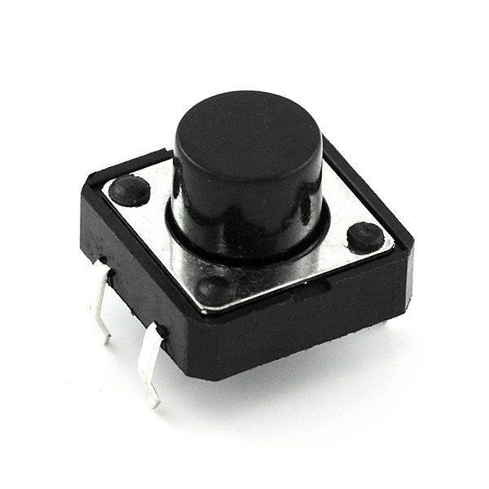
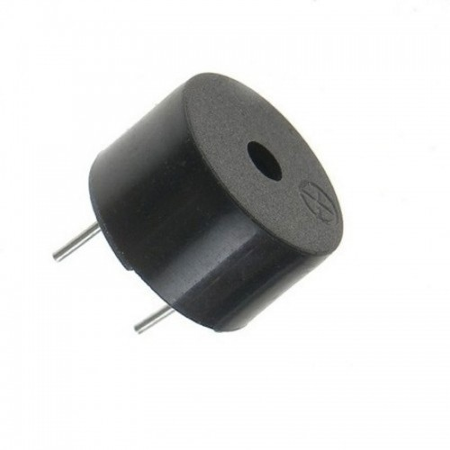
THE HARDWARE COMPONENTS
1 Push button
1 potentiometer
1 Piezo
Back to table of content

Slide 8
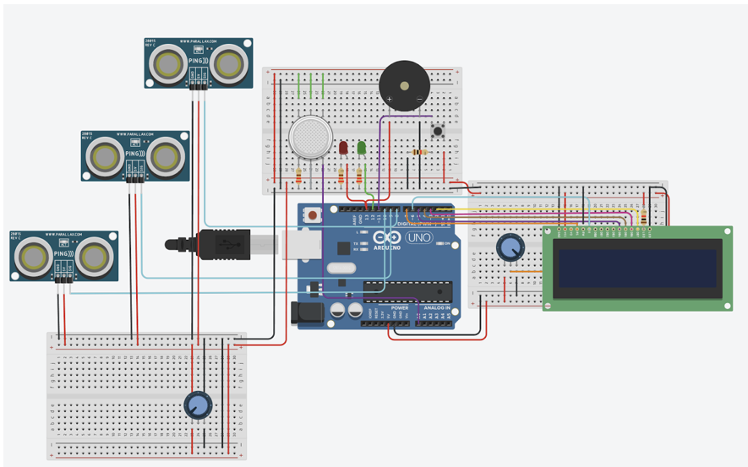
The circuit (turned off)
Back to table of content

Slide 9
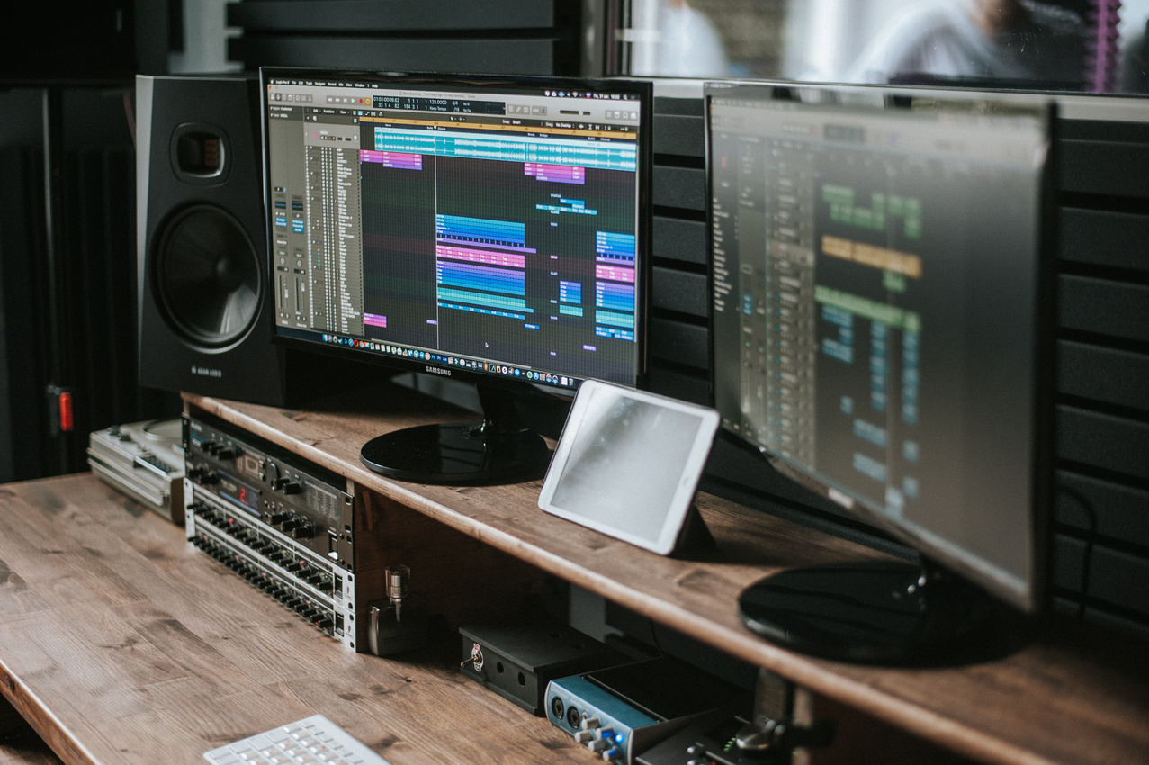


SOFTWARE
Back to table of content

Slide 10

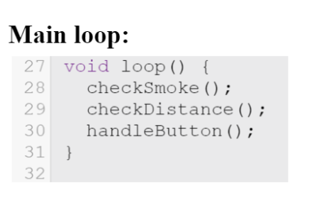
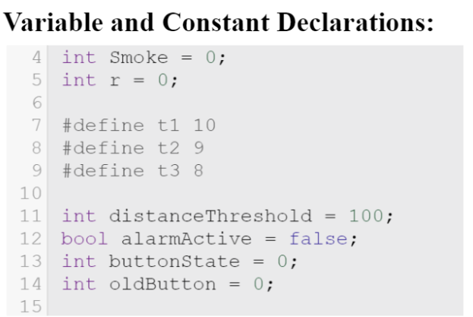
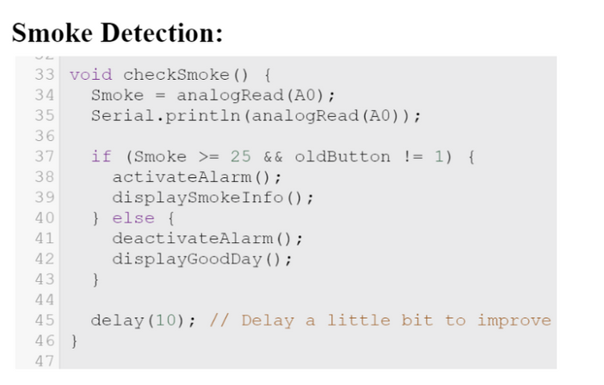
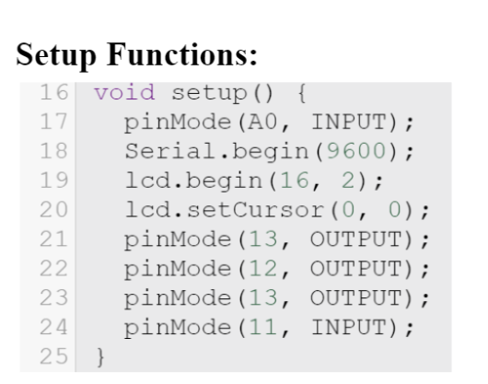


Back to table of content
CODE EXPLINATION

Slide 11
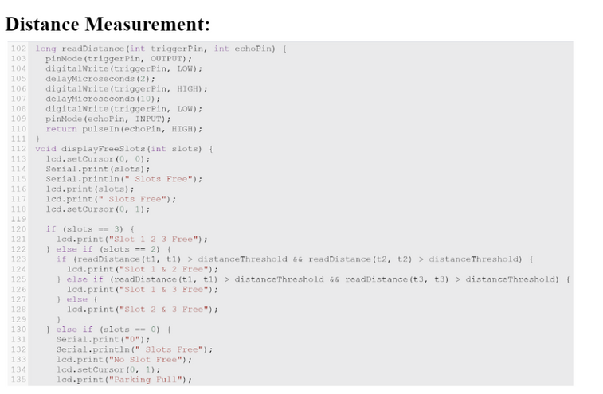
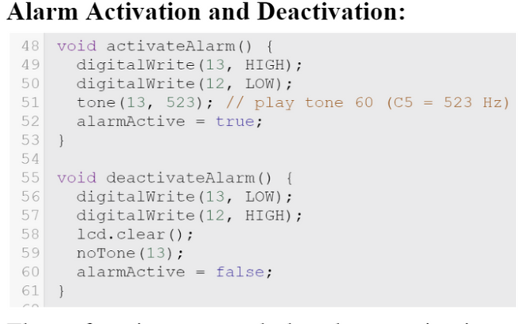
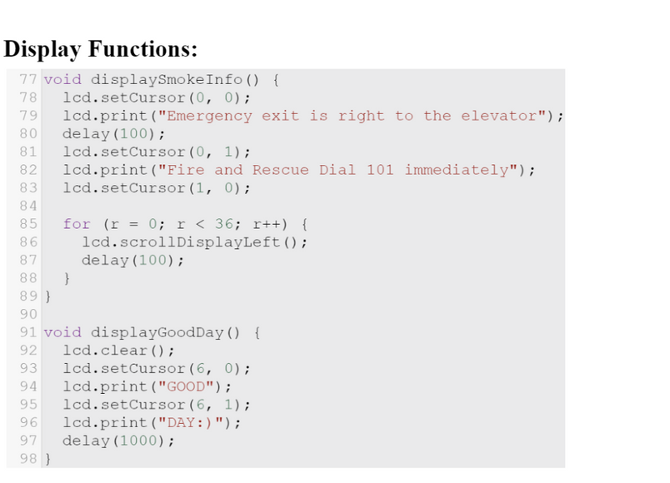

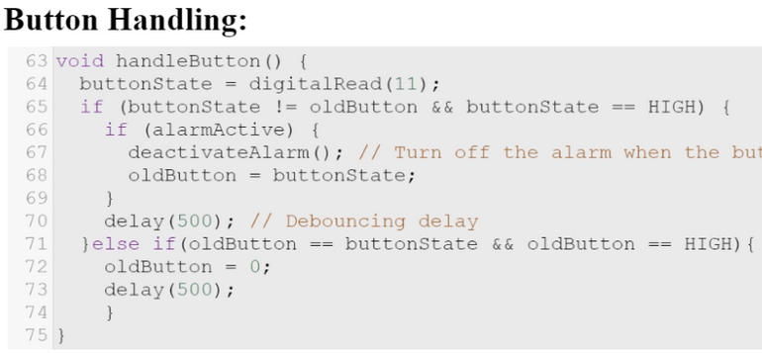
Back to table of content
CODE EXPLINATION

Slide 12
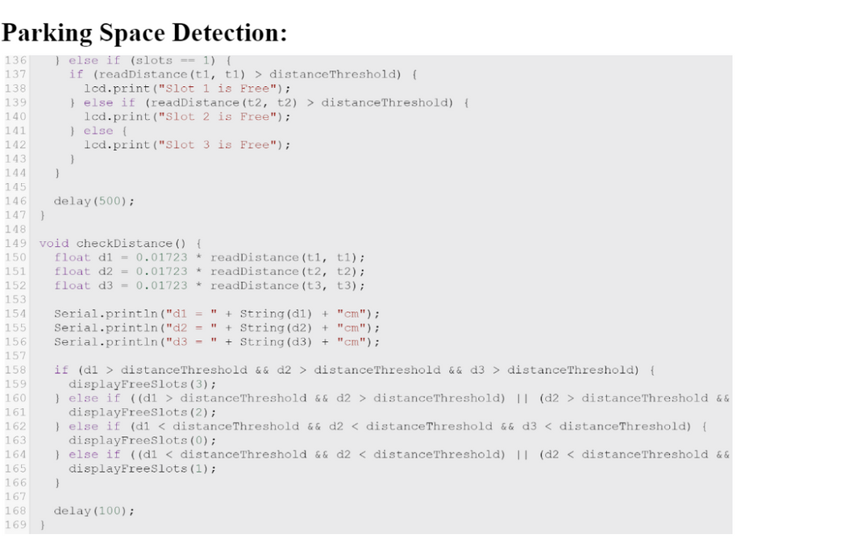
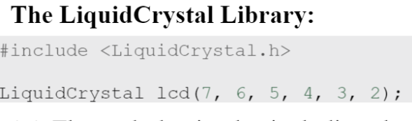
Back to table of content
CODE EXPLINATION

Slide 13
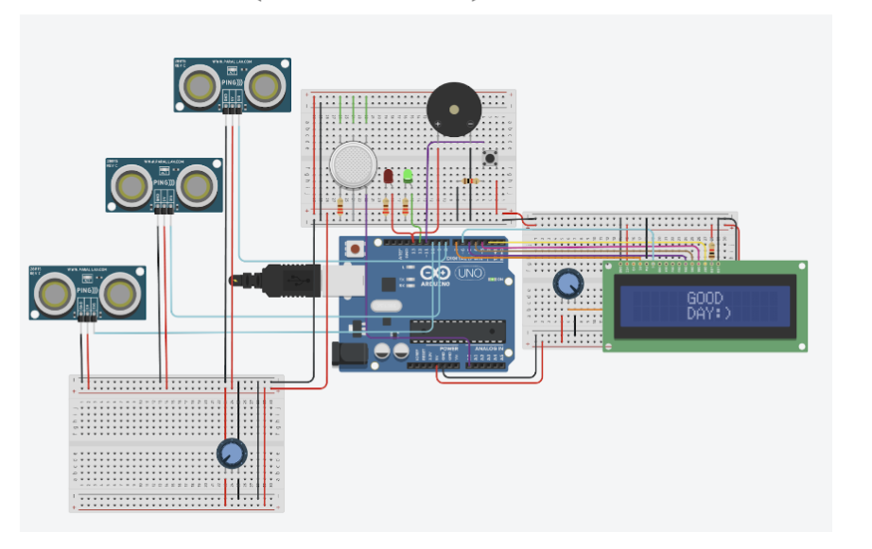
The circuit (turned on)
Back to table of content

Slide 14
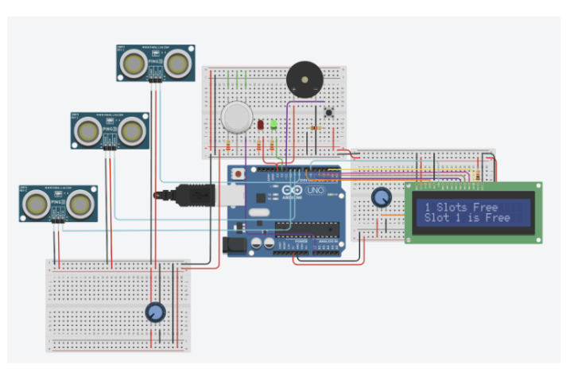
The circuit (turned on)
Back to table of content

Slide 15
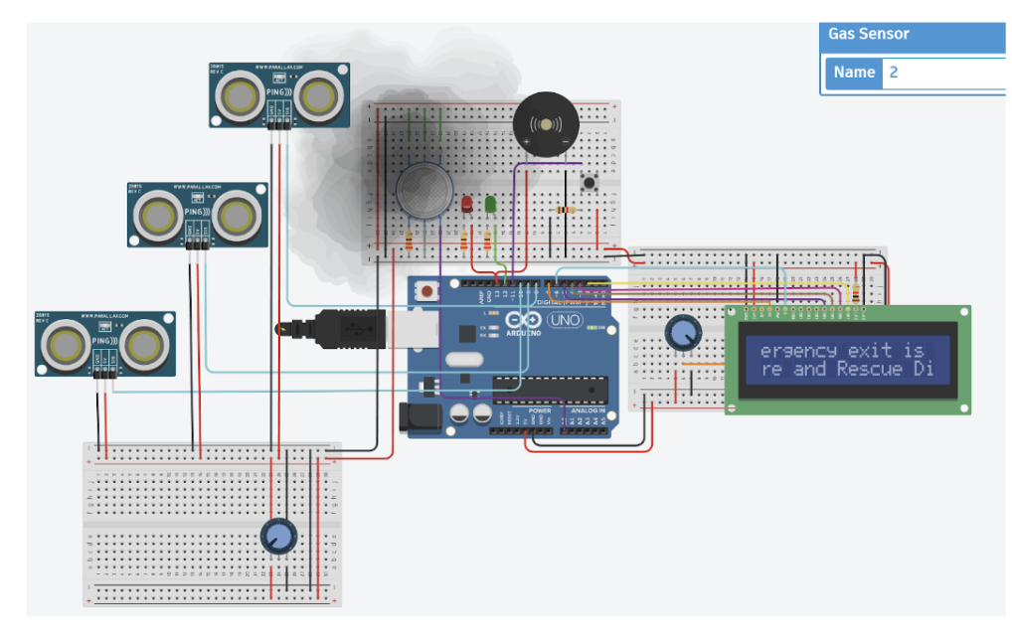
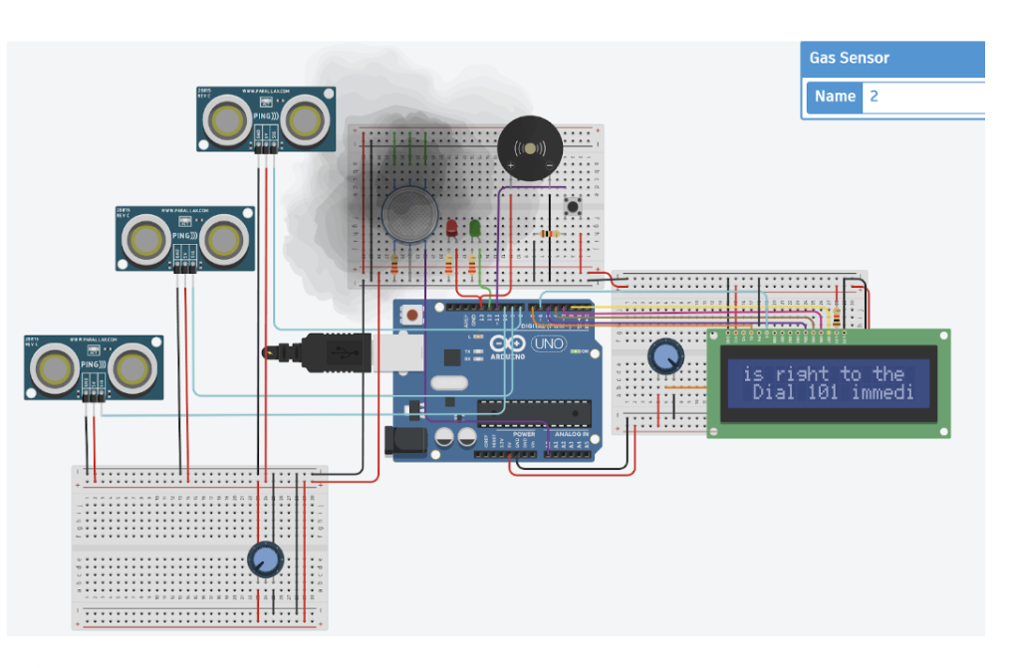
Back to table of content

Slide 16
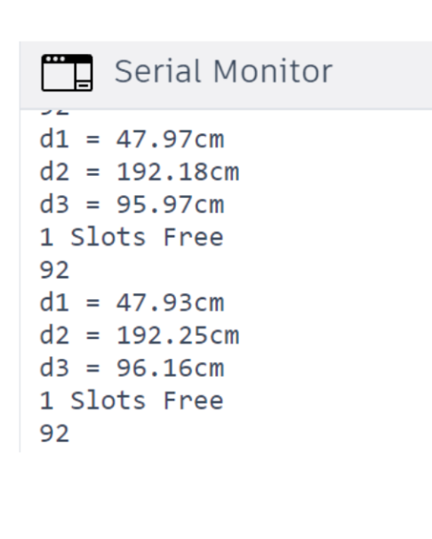
The serial monitor Output
Back to table of content

Slide 17
Related Work
RELATED WORK AND CONCLUSION
Researchers and developers in smart parking solutions explore distance measurement and space detection systems. Examples include ultrasonic sensor-based systems, computer vision solutions, IoT-enabled setups, and mobile apps. The described concept uses ultrasonic sensors for a cost-effective solution, differing from others in its straightforward approach to monitoring parking space availability.
Back to table of content

Slide 18
RELATED WORK AND CONCLUSION
Conclusion
Our Smart Parking System, using Arduino and sensors, envisions hassle-free, safe parking with fire detection. While our proof-of-concept is functional, challenges in accuracy and scalability exist. Future work may include wireless communication for real-time data, machine learning for optimal allocation, and addressing challenges for a more robust solution.
Back to table of content

Slide 19



THANK YOU!
Team members;
Reem - Haneen - Razan - Hajer

